Slide 1
Innovative Human-AI Interaction for Financial Data Exploration
START Hack 2025 - Materials
David de Lame, Guillermo Fajardo Calvache, Marin Puskaric
10.03.2025

Slide 2
Contents
1
SIX Financial Information
2
Financial Display Applications
3
Display Users and User Journey
4
Technical Environment
5
General Advice

Slide 3
SIX Financial Information

Slide 4

SIX is a leading global provider of financial data

Slide 5









How SIX adds Value to the Financial Industry
We receive raw data from over 5,000 global sources
We collect disparate, diverse, disorderly, and inconsistent data
We aggregate, streamline, enrich, optimize, and organize data
We deliver consolidated, complete, clean data in a uniform structure ready for our clients to use
consistent
Issuers
accurate
Exchanges
timely
Markets
complete

Slide 6
Supporting our clients globally
4,024
Employees (FTE 2023)
USA Miami, New York, Stamford CT
Switzerland Biel, Geneva, Olten, Zurich
Spain Barcelona, Bilbao, Madrid, Valencia
Poland Warsaw
19
Countries
Colombia Bogota
UK London
Norway Oslo
Monaco
Germany Frankfurt
Denmark Copenhagen
Morocco Casablanca
27
Locations
France Paris
Sweden Stockholm
Japan Tokyo
86
Nationalities
Netherlands Amsterdam
Luxemburg Leudelange
Singapore
Italy Milan
Belgium Brussels
6
Sensitivity: C1 Public

Slide 7
Financial Display

Slide 8


Financial Display
Financial display applications allow users to connect to a wealth of data in an intuitive way. The offer the flexibility to access data in the office, while travelling or when working from home.

Slide 9
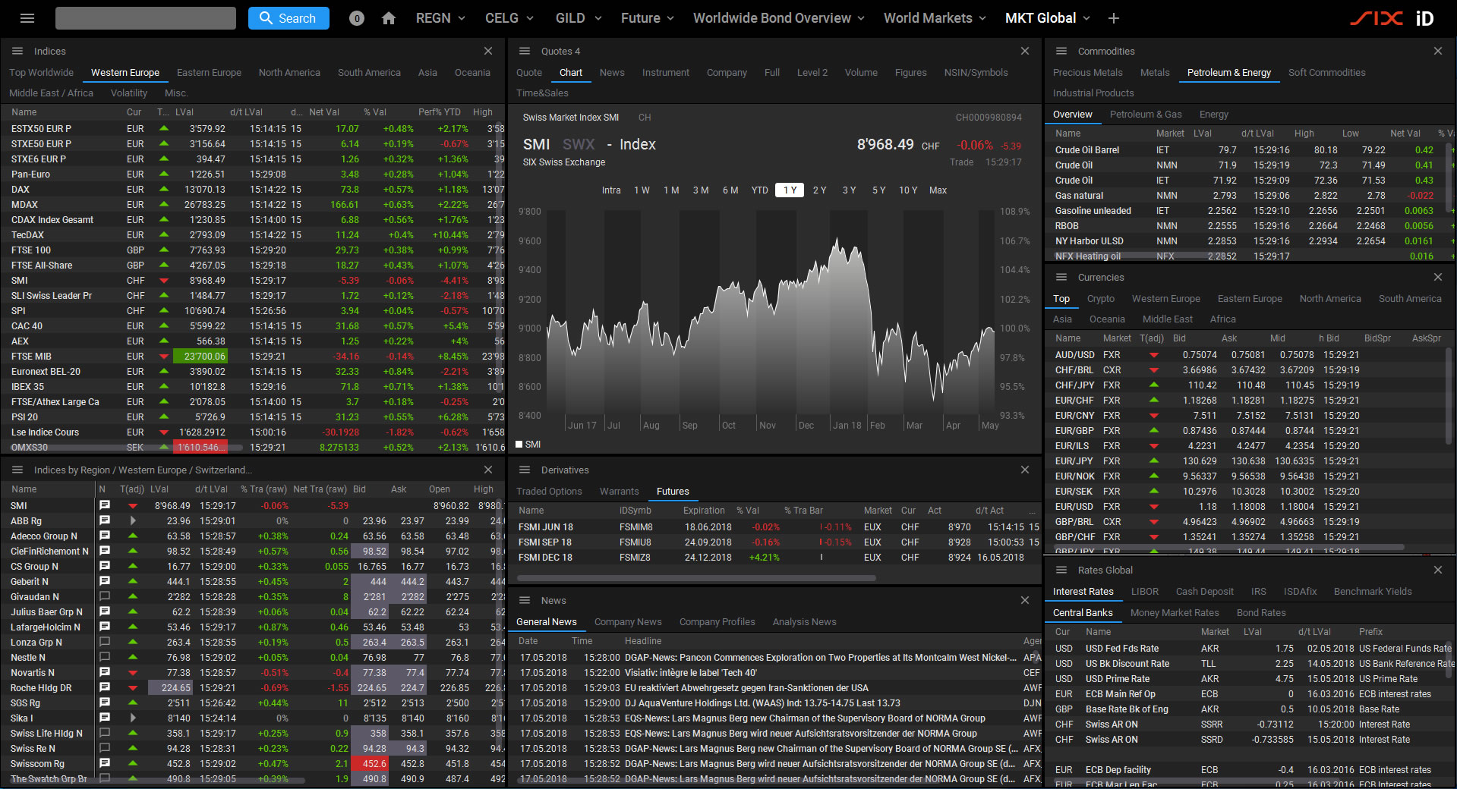
Financial Display
Financial displays keep user informed about the financial markets by providing high-quality reference and market data, as well as a wide range of regulatory content and tax information.
This wealth of financial data enables users to make investment decisions, mange their portfolio, all while staying compliant with regulations.

Slide 10
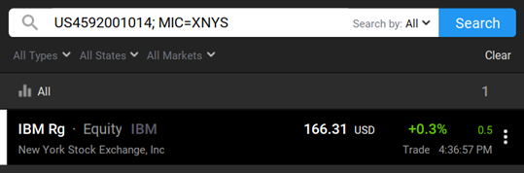
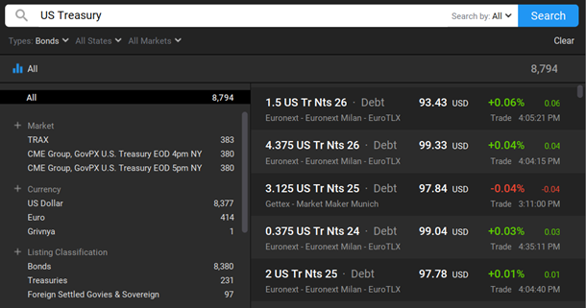
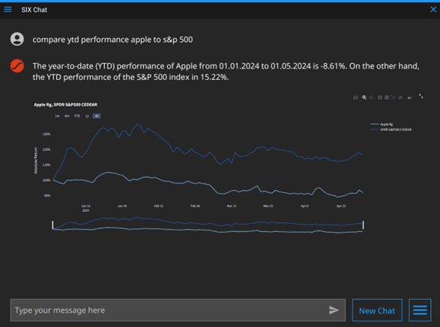
Evolution of Data Queries in the Financial Industry
Past
Present
Future
Command Search
Traditional method, structured and specific.
Natural Search
Use of keywords & criteria, more intuitive, “Google-like”.
AI Search
Understanding context, compounded questions capabilities.

Slide 11
Users & User Journeys

Slide 12

SIX iD Users
The Wealth Manager
A Wealth Manager is helping his clients grow their wealth while minimizing financial uncertainty.
A Wealth Manager’s work encompasses investment management, risk mitigation, tax optimization and retirement planning.
Context of a Wealth Manager’s Job
Wealth Managers provide financial advice, build trust and confidence and help clients establish long-term financial success.
As such a Wealth Manager serves as a trusted partner in managing finances confidently. Their guidance aims to align financial strategies with personal values of their client.

Slide 13

Wilson
Wealth Manager - Persona
Background Walter is an experienced wealth manager specializing in investment strategies and tax-efficient financial planning. Over the years, he has cultivated deep relationships with high-networth-individuals, helping them to manage complex financial needs and grow their financial wealth.
Use Cases Asses his clients' financial needs and goals Manage his clients’ financial portfolio Mitigate financial risks and tax impact | Goals Achieve strong returns and grow client's wealth Instill confidence and be a trusted partner
Pain-Points Time-pressure to answer client queries Communicate financial concepts understandably Assess a complex client's preference and needs Manage clients' expectations during downturns Navigate complex regulatory landscape | Gains from Financial Displays Monitoring of global markets Portfolio management Identify tax and regulatory restrictions Client reporting and presentations
13

Slide 14
Wilson
Wealth Manager – Use Cases
Functional Tasks
Wealth Management
Assess financial goals & risk tolerance Determine client needs based on income, preferences and financial objectives.
Manage investment portfolio Use financial display to assess the financial market developments and adjust portfolio.
Risk Management
Mitigate financial risks Hedge against market downturns, inflation, or interest rate changes.
Tax Optimization
Reduce tax exposure Assess the complexity of the client’s possessions and utilize tax-efficient management strategies
Long-Term Financial Planning
Develop a long-term financial roadmap Plan for major life events such as retirement, wealth transfer or inheritance.
Relationship Tasks
Instill Trust and Confidence
Be a trusted partner Build long-term relationships beyond just managing money.
Reduce uncertainty Help clients navigate market volatility and economic downturns.
Provide confidence in financial decisions Communicate complex financial concepts and strategies in understandable terms.
Work in Alignment with the Client’s Values
Assess Risk-Appetite Aligning financial goals with social good.
Discretion Clients want their wealth handled with discretion and professionalism.
Support Causes Aligning financial goals with social good.
14

Slide 15
Wealth Manager Journey
 | Client Engagement |  | Investment Strategy Definition |  | Wealth Management
Action | In the initial engagement the Wealth Manager is focused on building a relationship with their client. | When assessing the financial situation, the Wealth Manager is gathering all the hard data about their client’s finances. | The Wealth Manager then crafts a tailored wealth management strategy. | Wit the investment strategy, the wealth manager is deciding how to allocate the assets across investments opportunities. | The Wealth Manger executes on the strategies by opening investment accounts and allocating the assets. | The Wealth Manager is monitoring performance and keeping the client informed. | The wealth manager aims to foster and ongoing, positive relationship that can span decades, even generations.
Goal | Get to know the Client | Exhaustive Assessment of Finances | Create High-Level Strategy | Invest in accordance with client’s Goals and Risk-Appetite | Successful Implementation of the Investment Strategy | Ensure the Plan is on Track | Maintaining a good Relationship with the Client
Tasks | Listen and Learn Uncover the client’s financial goals, fears, aspirations, and priorities Build Trust High-net-worth families have unique dynamics and concerns. Discuss with tact and empathy. Partnership, Not Products Don’t provide pre-packaged solutions but engage in a collaborative discovery. | Comprehensive Inventory Gather relevant financial documents, such as current assets and investments, liabilities, retirement accounts, insurance coverage, and other asserts. Clarify Current Financial Position Create a net worth statement and cash flow analysis for the client. | Align with Goals and Risk Profile Base the strategy on the specific goals and the client’s risk tolerance. Holistic and Customized Plan: Develop a comprehensive plan that covers asset allocation strategy and tax optimization or insurance. Collaborative Review Review the strategy is prepared, review it in detail with the client. | Strategic Asset Allocation Determine an optimal mix of asset classes that aligns with the client’s return objectives and risk tolerance. Diversification Create a well-diversified portfolio to reduce market risks. Tax-Efficient Investments Align the investment plan with tax strategy. | Coordinated Action Create a detailed implementation checklist covering all aspects. Timely Execution Prioritize actions by importance and dependencies. Some steps might be time-sensitive. Administrative Diligence Given the volume of paperwork attention to detail is essential. | High-Quality Reporting Provide the client with clear, comprehensive portfolio reports at agreed intervals. Proactive Adjustments When the data indicates a need for change, act on it. | Regular Review Meetings Periodic reviews to discuss the financial plan and do changes based on the client’s circumstances. Continuous Communication Always maintain availability for the client and be proactive to reach out. Adapt and Evolve with the Client: Treat the wealth plan as a living document, as over time, the client’s objectives may shift.
Pain-Points | Establishing Rapport Wealthy clients may be cautious. Overcoming skepticism takes time. Uncovering Hidden Goals Clients might not immediately disclose all their objectives. It can be difficult to draw out all information. Family Dynamics Complex family structures lead to different expectations. Aligning them can be challenging. | Complexity and Volume HNW individuals tend to have many accounts and documents to track ​. Gathering them is time-consuming. Client’s Time and Patience Clients might have little patience for lengthy data gathering process. Data Accuracy: Ensuring that all information is up-to-date and correct is a challenge, | Reconciling Multiple Objectives HNW families can have numerous goals that don’t always align. Complex Solutions The strategies can involve complex instruments or structures. Expectation Management Clients might have preconceived notions or unrealistic expectations. | Concentrated Holdings Clients can have wealth tied up in a single asset – for example, the ownership stake in a business. Illiquidity of Assets Some client’s assets might not be easily tradeable (e.g., real estate) Changing Tax Laws Tax laws can change with new legislations, which can alter the effectiveness of defined strategies. | Multi-Advisor Coordination Need to coordinate with the client's other wealth managers. Client Hesitation Clients get be hesitant about certain recommendations and may introduce changes or delays. Operational Hurdles Transferring illiquid assets can take time or have restrictions. | Market Volatility and Noise Short-term volatility can spook clients, so it is necessary in helping cope with short term market noise. Portfolio Underperformance When a period doesn’t yield positive results the wealth manager needs to explain why and what’s being done. Evolving Industry Landscape: Keeping up with newly introduced financial products and opportunities. | Maintaining Engagement Over the relationship clients can become less engaged, but it is important to keep them involved. Generational Transitions When wealth is being passed to the next generation, the relationship can become complicated. Delivering Consistent Value Wealth Managers need to continue adding value – by introducing a new idea or finding an overlooked risks.

Slide 16
Technical Enviroment

Slide 17
API Endpoints
Users will be provided with a real time API through an URL.
Updated documentation will always be available through the “docs” endpoint.
This API emulates through endpoints the different aspects of an LLM based agent.
Query: Main LLM endpoint. Receives strings of natural language that are directly ingested by the agent.
LLM: General access to query the underlying LLM.
OHLCV: Price retrieval endpoint. Receives three inputs and returns price data for companies.
NonStockPrice: Price retrieval tool for instruments that are not companies, such as indexes, commodities or exchange rates.
WinnerData: Retrieves data from precalculated lists. User will input a selected market, time frame and requested data and receive the information in a table friendly format.
GetData: Endpoint for general data requests that is not present in price data (i.e. employees of a company, EBITDA, last dividend, etc.). Users will provide a query parameter with all their requests and will receive the answers in a table friendly format.
SearchWithCriteria: Search companies that fulfill an n number of criteria. Users will input a dict friendly string consisting of the concepts and logical requests of their criteria (such as "{'ebitda': 'is positive’, ‘currency’: ‘is euro’}“ and Will receive a table friendly response with up to 200 companies that fulfill such criteria

Slide 18
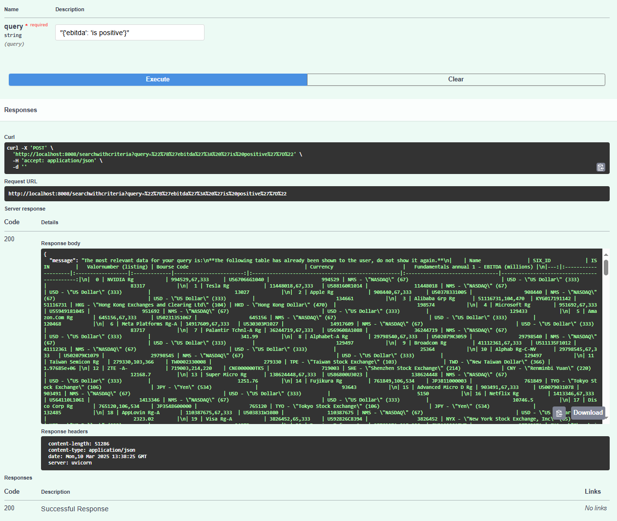
API interpretation
Included in the documentation, users will receive:
Full description of each parameter.
Full response schema for easy interpretation.
A sample of representative requests and their responses.
Hints to edge cases.
A full python library to interact with the API.
Endpoint responses will always contain a “message” and “object” key that do represent a natural language summary of the result and a full data object.

Slide 19
General Advice

Slide 20
General Advice
Ensure JSON Formatting: Always validate JSON inputs before sending requests to prevent errors.
Authentication: If using authentication params, ensure proper session management to avoid access issues.
Rate Limiting: Avoid excessive queries in a short period to prevent service throttling.
Error Handling: Always check the API's error messages to troubleshoot issues effectively.
Data Handling: Be mindful of response structures, especially for large data responses such as OHLCV.

